Slide 1

Intro to
Programming
With python
Files:
Part III
Wednesday, Apr 9 2025 TOH210
Notes:
Layout objects pulled from: https://slidesgo.com/
All icons are from: https://thenounproject.com/

Slide 2

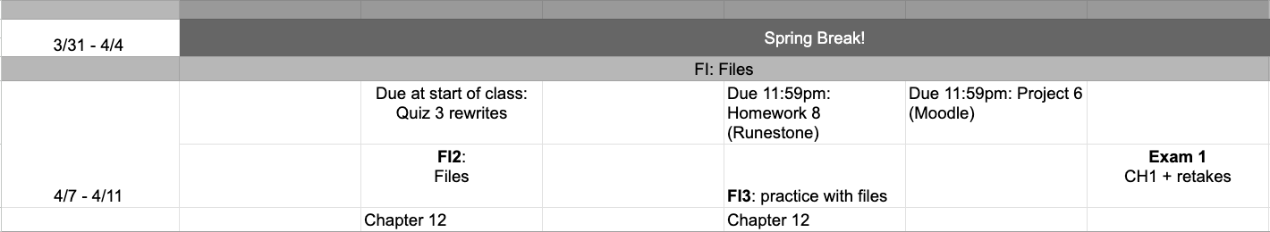
This week
google sheet link
Exam 1 this Friday (entire class period)
Second attempt on standards from Quizzes 1-3, and first attempt on first challenge standard CH1. Suggestions for studying: review slide decks; redo workbook exercise; solve problems by hand, then type into IDLE to check work; attend TA help sessions and/or office hours
Notes:
https://docs.google.com/forms/d/e/1FAIpQLSe3OloPAJSid4n6cyU_4qXpRWU7FOSmP7IVdRS_vh9cvYd9zQ/viewform?usp=sharing

Slide 3
readlines
The file method readlines gives us another option for reading from a file, returning a list of all the lines from the file
bunny = open("snooze_bunny.txt", "r")
bunny_lines = bunny.readlines()
(\(\ ~zzzzz~
( -.-)
o_(")(")
would give us the list:
[" (\\(\\\t~zzzz~\n", " ( -.-)\n","o_(\")(\")"]

Slide 4
csv files
A csv, or comma separated value, file is a type of text file with special formatting
The formatting of a csv file allows for the data to show up as a table
Rows are separated with newline characters
Within each row, columns are separated by commas

Slide 5
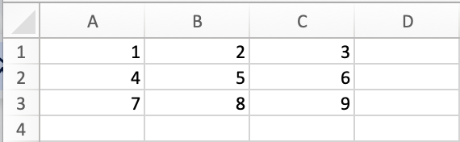
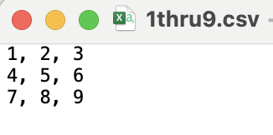
In a spreadsheet, this information may look like this (rows 1-3, col A-C):
grab this file from Moodle!
example of a csv file
Let’s take a look at 1thru9.csv
As a string, this would look like:
'1, 2, 3\n, 4, 5, 6\n, 7, 8, 9'
where each row is separated by \n
and each column within that row is separated by a comma
In a text file, this information may look like this (row on new line, columns by commas):

Slide 6
so how do we work with a csv in python?
Our goal is to translate the table structure in a csv into a Python object that contains the same data.
We can do this with nested lists!
each row can be stored in a list
[1, 2, 3]
[4, 5, 6]
[7, 8, 9]
and we can store all rows together in one larger list, separated by commas
[[1, 2, 3], [4, 5, 6], [7, 8, 9]]

Slide 7
How to construct a list of lists
We can use readlines to get a list of lines from the file
['1, 2, 3\n', '4, 5, 6\n', '7, 8, 9']
Let’s try this together!
Make sure to have 1thru9.csv saved in a folder you can locate.
Create a Python script named csv_to_list.py and make sure it is saved to the same place as the csv
1
We can use the string method strip to remove \n from each row
['1, 2, 3', '4, 5, 6', '7, 8, 9']
2
We can use split to split up each line based on commas
[['1', '2', '3'], ['4', '5', '6'], ['7', '8', '9']]
3
We can iterate over each row and column to cast entries to ints
[[1, 2, 3], [[4, 5, 6], [[7, 8, 9]]
4

Slide 8
How to construct a list of lists
numbers_file = open("1thru9.csv", "r")
table = numbers_file.readlines() #1
numbers_file.close()
for row in range(len(table)):
table[row] = table[row].strip().split(',') #2 #3
for col in range(len(table[row])): #4
table[row][col] = int(table[row][col])
print(table)

Slide 9
How do we grab A ROW from the table?
We can use indexing!
syntax table[row]
row 0
row 1
row 2
table = [[1, 2, 3], [4, 5, 6], [7, 8, 9]]
col 0
col 1
col 2
col 0
col 1
col 2
col 0
col 1
col 2
table
[2]
would give us [7,8,9]

Slide 10
How do we grab ONE ITEM from the table?
We can use indexing!
syntax table[row][col]
row 0
row 1
row 2
table = [[1, 2, 3], [4, 5, 6], [7, 8, 9]]
col 0
col 1
col 2
col 0
col 1
col 2
col 0
col 1
col 2
table
[2]
[1]
would give us 8

Slide 11
How do we grab A COL from the table?
We can use a for loop to go through all rows, grabbing the correct column
syntax
for row in table:
row[col]
row 0
row 1
row 2
table = [[1, 2, 3], [4, 5, 6], [7, 8, 9]]
col 0
col 1
col 2
col 0
col 1
col 2
col 0
col 1
col 2
for row in table:
row[1]
will grab all green items

Slide 12


EXAMPLE
csv practice
let’s try this out together
Use the file 1thru9.csv to compute and print the following:
the sum of numbers from col 1
the sum of all numbers in the entire file
the sum of numbers from row 1
Remember, these are nested lists.
Use print statements to
debug what you are doing
15
45
15
col 0
col 1
col 2
row 0
row 1
row 2

Slide 13
Exercise
pokemon csv
Open up the word document posted on Moodle. Download pokemon.csv and answer the following questions:
Open pokemon.csv. What does each row represent? What are the columns of information we have?
Find and print the number of Pokemon in the dataset.
Print the names of the first ten Pokemon from the file.
Count the number of Pokemon with Grass as Type 1.
Find the average HP of all Pokemon.
Count the number of Pokemon who’s names begin with the letter “B”.
Print the names of only the legendary pokemon.
Find the name of the pokemon with the largest value in the Total column.

Slide 14

before next time
Finish exercises
Submit HW 8
Submit Project 6
Study for CH1

Slide 15
How to sum things from 1thru9.csv
#sum of row 1
sum_row1 = 0
for item in numbers[1]:
sum_row1 += item
print(sum_row1)
#sum of col 1
sum_col1 = 0
for row in numbers:
sum_col1 += row[1]
print(sum_col1)
#sum of all things
sum_all = 0
for row in numbers:
for col in row:
sum_all += col
print(sum_all)
Note: there are many ways to do this! Pick the one that best suits you (either iteration by index or item)

